Slide 1
Twitter Homework Setup

Slide 2
Set up a Twitter developer account
To be able to use the Twitter APIs, you’ll need to register as a Twitter app developer and obtain keys and access tokens. You’ll need to replace the keys and tokens in config.cfg with your keys and tokens
Download the two files tweetering.py and config.cfg from Camino and place them in the same directory
Sign in on https://apps.twitter.com/ using your Twitter account
Click on “create new app”
Click on your app name
Click on “Keys and Access Tokens”
In this page, you’ll find a consumer_key, consumer_secret, access_token, and access_token_secret
Copy your keys and tokens into config.cfg

Slide 3
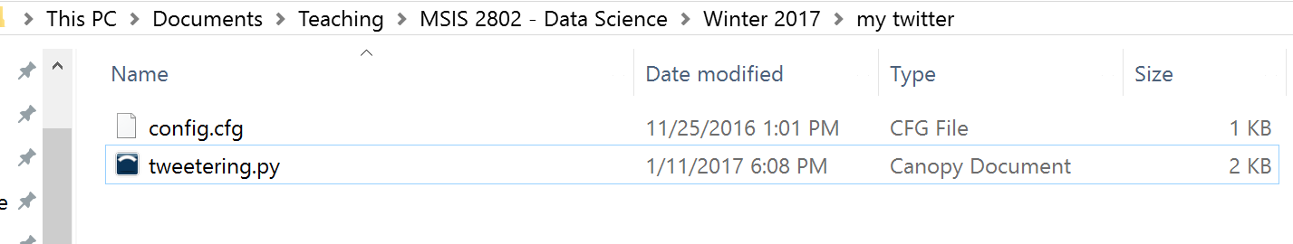
Open tweetering.py with Canopy Editor
Double click

Slide 4
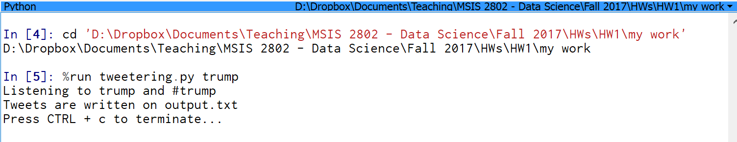
Run!
1. Change directory to the one containing your twitter files
2. To run the program, type:
%run tweetering.py word
Where word is the term you want to look for
(here the word is “Obama”)
3. The program creates an output file with the tweets collected
4. Stop collecting tweets by pressing CTRL + c

Slide 5
Problems
Tweepy not found:
(1) Go to Canopy Package Manager, (2) click on available, (3) look for tweepy

